Slide 1
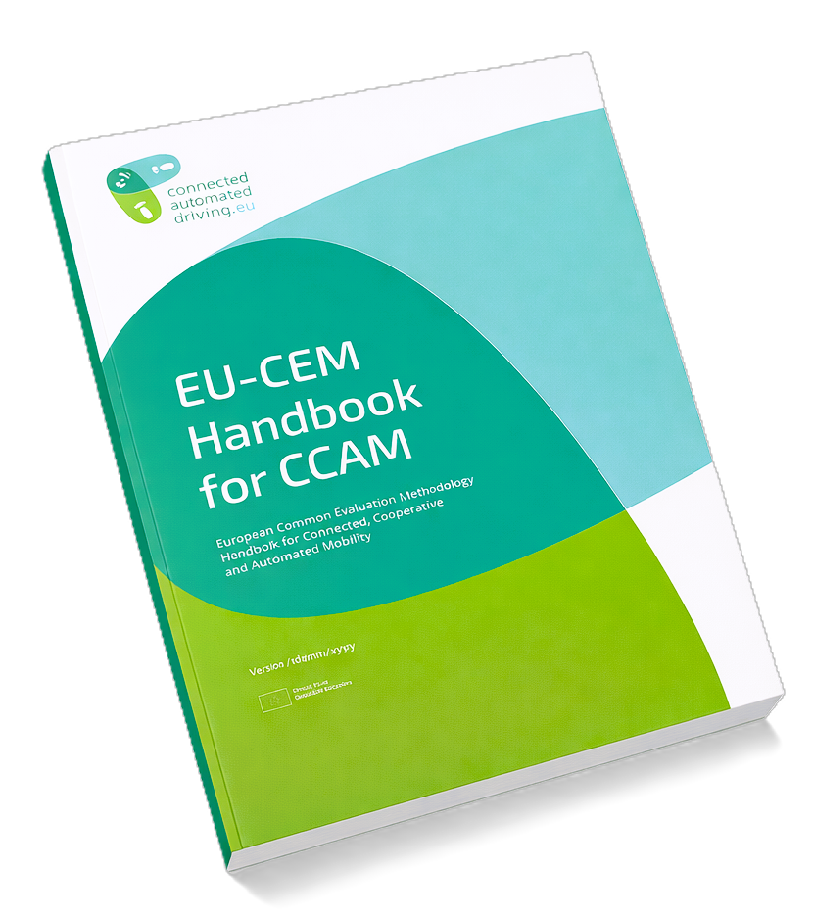
Cascading Impacts
Guidance for Evaluation Teams on How to Build Pathways to Describe Cascading Impacts of CCAM

Slide 2
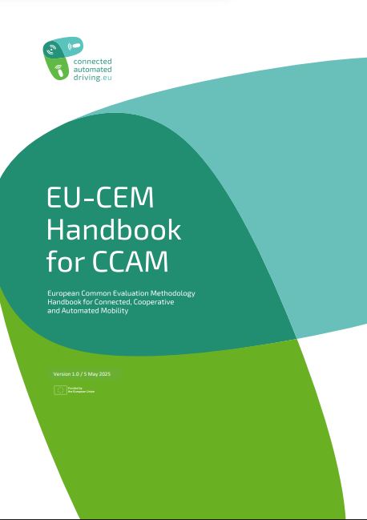
Introduction
This slide set is part of the training materials that support the use of the European Common Evaluation Methodology (EU-CEM) for Connected, Cooperative and Automated Mobility (CCAM).
The slide set
  Is intended for professionals in evaluation activities in CCAM projects. It is not a substitute for expertise.
  Introduces the concepts of impact mechanisms and impact pathways.
    Describes how these can be used to identify potential cascading impacts.
  Builds on the concepts introduced in the EU-CEM Handbook. References to relevant chapters
  are marked with the EU-CEM Handbook icon.
The EU‑CEM Handbook explicitly highlights the need to consider direct, indirect, and unintended impacts and linkages between impact areas, and offers guidance on how to address this need.

Slide 3
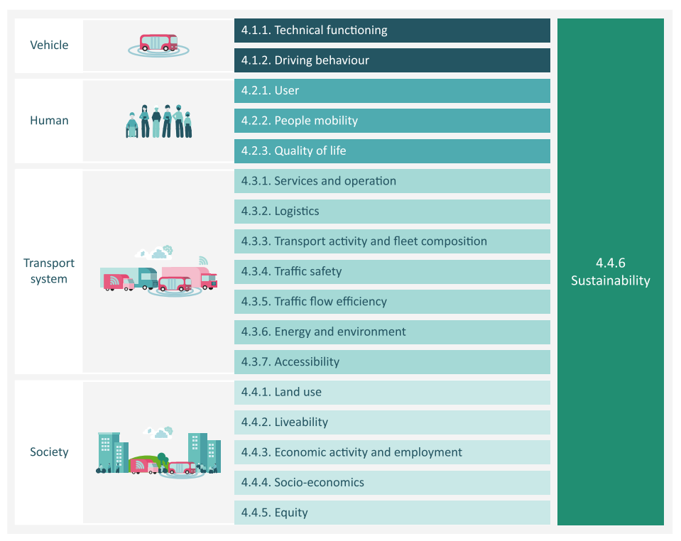
18 Evaluation and Impact Areas
CCAM can cause changes on the level of (1) single vehicles and (2) humans, on (3) the transport system and (4) the society overall.
The EU-CEM Handbook covers all four levels.
An evaluation area is defined as “a high-level category for topics addressed under evaluation activities”.
These are technical evaluation, user evaluation, and impact assessment.
An impact area is defined as “a field of study addressed under impact assessment activities”. These are e.g., Driving behaviour, People mobility, Traffic safety, and Equity.
Sustainability is placed across other impact areas as most impact areas described in the handbook relate to one of its three pillars: environment, society, and economy.
The EU-CEM strongly recommends all projects to reflect on their results from a sustainability perspective, regardless of the impact areas chosen for evaluation.
Further reading: Chapter 1.2.3. (p. 19), Chapter 4

Slide 4
What are Cascading Impacts?
CCAM systems rarely affect a single impact area in isolation.
  CCAM can have wide-ranging consequences for how cities, regions, and logistics systems are organised, where we live, what available jobs are, how spatial development unfolds, and who has access to mobility.
In addition to direct and intended impacts (e.g., improved comfort, safety), CCAM can have indirect, possibly unintended impacts.
  These include increased car use and behavioural adaptation among non-users.
The direct changes caused by CCAM at the vehicle or service level can propagate, e.g., through user behaviour, mobility patterns, and accessibility, ultimately affecting the entire transport system and potentially wider society.
  Impact areas are interconnected through dependencies and feedback loops.
Broader indirect, sometimes unintended, consequences that form through cause-and-effect-chains and complex interactions following the introduction of a new technology are called cascading impacts.
Further reading: Chapter 3.3 (p. 53)

Slide 5
Why do Cascading Impacts Matter?
Cascading impacts often result from gradual processes and can take years to fully manifest
  → they can be difficult to detect and quantify.
  Impacts can be so far-reaching that no single project can address them all in detail.
    Nevertheless, a qualitative assessment is recommended.
    At minimum, potential impacts should be acknowledged.
Addressing cascading impacts can reveal broader, long-term consequences that might otherwise go unaccounted for. Ignoring them risks:
  Over- or underestimating the long-term impacts of the CCAM system.
  Overlooking important indirect impacts, whether general or affecting specific population groups.
When potential unintended consequences are identified, action can be taken to mitigate them in the further development or deployment of CCAM.
Further reading: : Chapter 3.3 (p. 53), Chapter 4 Impct pathway figures

Slide 6
Impact Mechanisms and Pathways
Impact mechanisms and pathways are useful tools for identifying cascading impacts and understanding evaluation results.
Impact mechanisms describe through which changes the impacts of CCAM occur.
  Example: The CCAM system improves user comfort by reducing the frequency of high-jerk acceleration.
Impact pathways are visual or conceptual maps illustrating cause-and-effect-chains and chain reactions that can (indirectly) occur through (direct) changes in another impact area.
By tracing them, potential chains of impacts (pathways) between the CCAM system and intended or unintended impacts can be identified.
Further reading: Chapter 2.2 (p. 25), Guideline 3.15 (p. 62)

Slide 7
Impact Mechanisms and Pathways (II)
Impact pathways can serve different functions:
  Identify interdependencies between different impact areas, often addressed by different project teams.
    Considering these linkages helps draft a realistic timeline for the project and identify areas where collaboration across teams is needed.
  Ensure coherent evaluation based on a thorough understanding of cause-and-effect relationships.
  Check against unrealistic expectations, e.g., where an expected societal impact lacks a plausible cause.
    They can also help describe the boundaries of a study by clearly showing what is within scope and what falls outside.
  Identify prerequisites for achieving call requirements or certain desired benefits, such as societal goals.
Further reading: Chapter 2.2 (p. 25), Guideline 3.15 (p. 62)

Slide 8
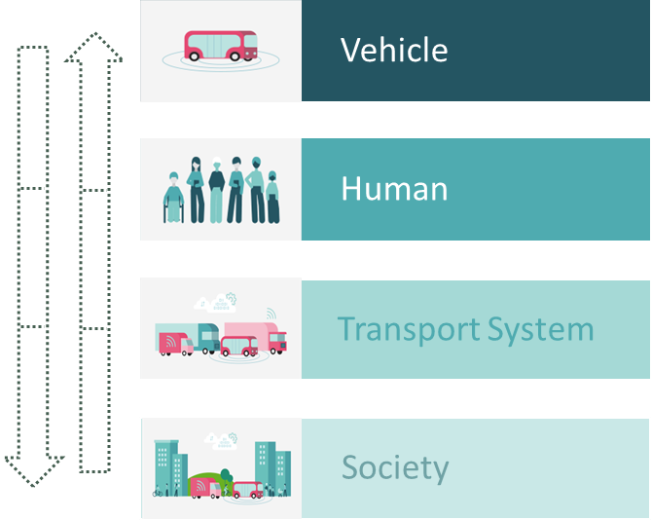



Drafting Impact Pathways
Start by analysing the CCAM system description and assessing how the CCAM system might affect the vehicle- and human-level impact areas (e.g., driving behaviour, comfort), for both users and non-users.
  What immediate changes does the system cause to humans inside or outside the vehicle?
  What are the differences in driving behaviour between automated and manually-driven vehicles?
If a specific societal-level impact area that the project should address is already known (e.g. by the call text), map different paths from the vehicle-level, through human and transport-system levels, to the societal-level impact area.
If no societal-level areas are given, start by tracing the impact pathways from vehicle- and human- level areas towards transport system and societal levels.
  Prioritise the areas where substantial impacts, benefits and burdens are expected, balancing with available resources.
Note that there may be alternative pathways between the same starting and ending points. The same direct effects can lead to several different cascading impacts.
Further reading: Chapter 2.2 (p. 25), Chapter 4 Impact pathways

Slide 9
Drafting Pathways Example
In the following slides, we trace an example of how an impact pathway is developed by an imaginary evaluation team preparing a high-level evaluation plan for a project proposal.
The call text addressed by the proposal includes the objective of assessing the impacts of CCAM systems on land use.
The team studies the system description of the CCAM to be tested in the project and, drawing on their expertise, drafts potential cause-and-effect paths through which deployment of the CCAM system might affect land use.
?
CCAM System
Land Use

Slide 10

How Does CCAM Affect Land Use?
Example: The CCAM system affects user experience and acceptance by changing the driving or travel experience.
Using domain expertise, the team forms the following hypotheses:
  Travelling with the new CCAM system is more comfortable than with previously available options.
  As acceptance and comfort increase, people perceive travelling as less burdensome.
  People become willing to tolerate longer trip durations or to travel more frequently.
  The spatial and temporal boundaries of the users’ daily lives expand.
  Over time, people may move further from city centres.
Start by understanding the CCAM system description.
Identify what kind of changes its use could bring to users and non-users in terms of vehicle- and human-level impact areas. (Technical functioning, Driving behaviour, User, People mobility, Quality of life).
?
CCAM System
Land Use
10

Slide 11
How Does CCAM Affect Land Use?
Hypothesis | Impact Mechanism | Evaluation Level – Impact Area
Travelling with the new CCAM system is more comfortable than with previously available options | The CCAM system affects user experience and acceptance by changing the driving or travel experience | Human – User
As acceptance and comfort increase, people perceive travelling as less burdensome | Changes in perceived travel experience affect the value of travel time | Human – People mobility
People become willing to tolerate longer trip durations or to travel more frequently | Changes in value of travel time affect the distance people are willing to travel to daily activities | Human – People mobility
The spatial and temporal boundaries of the users’ daily lives expand | The distance people are willing to travel affects the set of reachable activities and destinations | Transport system – Accessibility
Over time, people may move further from city centres | Over longer timeframes, changes in reachable destinations affect location choices of households and businesses, which can gradually reshape land use distribution (e.g., where housing, jobs, and services concentrate), as accessibility changes alter the attractiveness of different areas | Society – Land use
?
CCAM System
Land Use
11

Slide 12
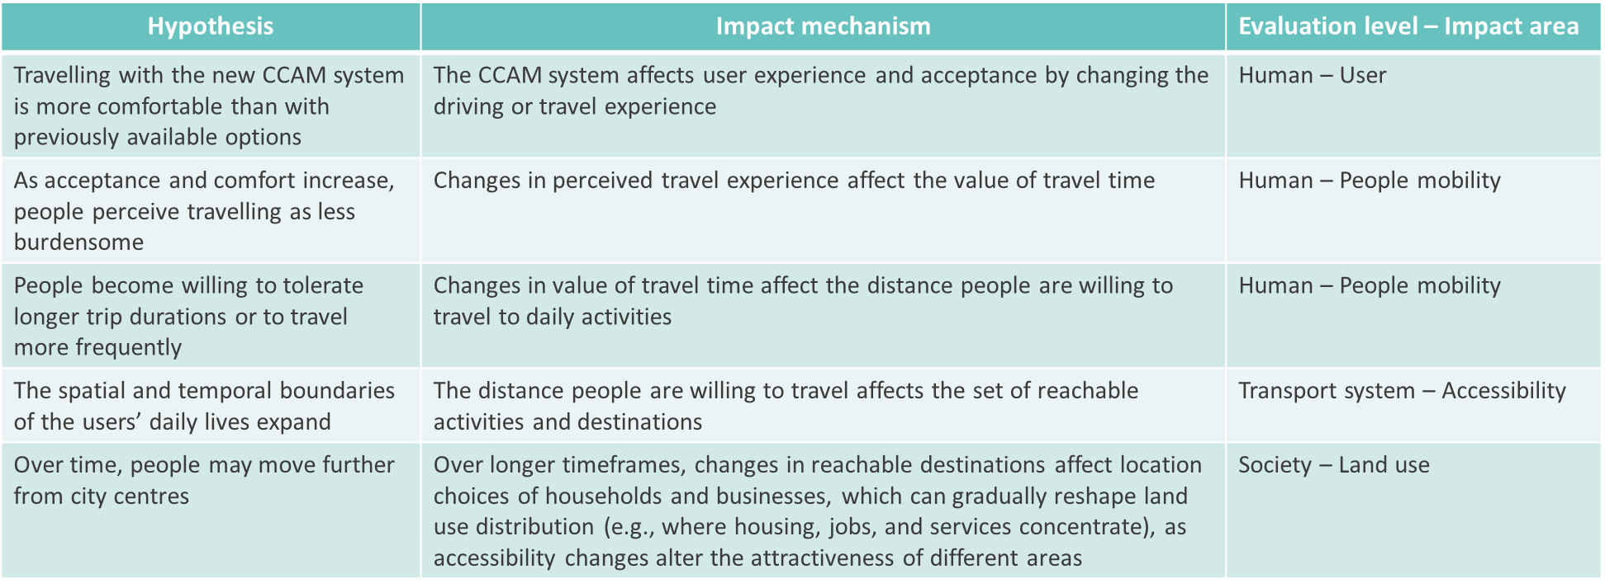




How Does CCAM Affect Land Use?
Convert the impact mechanisms, identified on the previous slide, into a pathway illustration.
Impact Pathway
CCAM System
User experience. Acceptance
Value of
travel time
Length of trips
Reachable destinations
Land use distribution
12

Slide 13
Key Takeaways
Impacts of CCAM can cascade
Direct changes at the vehicle and human levels propagate through to transport system and societal impact areas, not only as intended impacts but also often indirectly and sometimes unintentionally.
Cascading impacts matter even when they are hard to detect or measure
They often develop gradually and are difficult to quantify. Ignoring them risks over- or underestimating long-term impacts and overlooking impacts on specific population groups.
Impact pathways are a tool
  Use them to map cause-and-effect chains across the four evaluation levels (Vehicle → Human → Transport System → Society).
  Identify linkages and dependencies.
  Define what is within or outside the scope.
Pathways work in both directions
Trace pathways forward from the CCAM system to identify relevant impact areas or trace them backward from a societal goal to determine prerequisites and data needs.

Slide 14
Download the EU-CEM Handbook and check related materials at
https://www.connectedautomateddriving.eu/methodology/common-evaluation-methodology/

