Slide 1
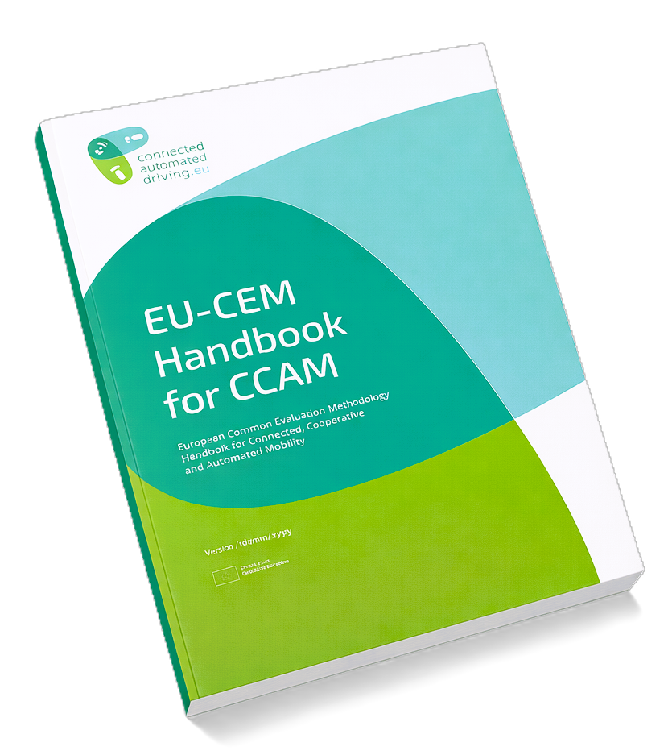
Key Pitfalls in CCAM Impact Assessment
Training Material for EU-CEM Handbook Users
Version: 18 May 2026

Slide 2

Introduction
This slide set is training material for the users of the EU-CEM Handbook, including:
Key pitfalls in CCAM impact assessment.
Guidance on how to prevent them, in line with the EU-CEM Handbook (Chapter 2 and 3).
A practical checklist for avoiding these pitfalls.
EU-CEM Handbook can be downloaded at:
https://www.connectedautomateddriving.eu/methodology/common-evaluation-methodology/
Disclaimer: This slide set covers a subset of the pitfalls discussed in the handbook; therefore, readers should also consult the relevant sections of the handbook for further guidance. Note that the handbook provides support and guidance, but it is not a substitute for evaluation expertise.

Slide 3
Table of Contents
Slide 4 - Pitfall: No agreement on evaluation scope
Slide 5 - Pitfall: Evaluation partners disconnected from others
Slide 6 - Pitfall: Different understanding of CCAM system
Slide 7 - Pitfall: Evaluation plan with research questions which cannot be answered
Slide 8 - Pitfall: Results do not relate to the same big picture
Slide 9 - Pitfall: Data cannot be shared for evaluation
Slide 10 - Pitfall: Data collection with unfit experimental design
Slide 11 - Pitfall: Methodological disagreement after evaluation completion
Slide 12 - Checklist for avoiding the key pitfalls in this slide set

Slide 4

PITFALL: No agreement on evaluation scope
What goes wrong
EU-CEM guidance
Misaligned views lead to unrealistic expectations, weak support and missing data.
The expected impacts of CCAM are wide-ranging. If the evaluation scope is not agreed during the planning phase, this may lead to different and unrealistic expectations about what the evaluation should deliver.
These expectations can exceed the available time, data, budget, and expertise.
It may also make it difficult to convince the consortium to collect data for evaluation they do not consider justified.
As it is not possible to assess all potential impacts, it is crucial to:
  Agree on evaluation scope in the proposal phase, and ensure it is aligned with the overall project goal.
  Define the key terminology to avoid misunderstandings.
  Prioritise impact areas based on requirements, scope, available resources, and expertise.
  Ensure that the evaluation scope and the available tools and skills are aligned.
  Clearly document how evaluation activities align with the overall project scope.
For more information: See Chapter 2.1 of EU-CEM Handbook (page 23)

Slide 5
PITFALL: Evaluation partners disconnected from others
What goes wrong
EU-CEM guidance
Disconnected working practices affect the consistency, validity, and usefulness of results.
Failures, delays, and misunderstandings in activities that provide input to the evaluation can disrupt the evaluation process.
Disconnection from the technical team can result in discrepancies between the evaluation assumptions and the real-world implementation.
When evaluation partners do not work as a team, they may adopt different assumptions and different ways of implementing the methodology.
As a result, evaluation outcomes do not complement each other. They fail to provide a coherent view of the system being evaluated, reducing the validity and usefulness of the results.
A logical project structure that supports interaction is a foundation for effective governance and success:
During the project preparation phase, design the project structure and governance.
  to support regular interaction between evaluation, technical, and test-site teams, and
  to facilitate internal coordination within the evaluation team to ensure alignment across evaluation and impact areas, and evaluation approaches.
  Ensure that work packages, timelines, milestones, and interdependencies are clearly defined and easy to understand.
  Allow flexibility for necessary adjustments while ensuring that the evaluation remains feasible within time and budget constraints.
For more information: See Chapter 2.2 of EU-CEM Handbook (page 27)

Slide 6
PITFALL: Different understanding of the CCAM system
What goes wrong
EU-CEM guidance
Planning evaluations based on false understanding of the CCAM system under evaluation leads to low quality results.
Different understandings of the CCAM system or service concept under evaluation can create discrepancies between the evaluation assumptions and real-world implementation, reducing the validity of the results.
If understanding diverges within the evaluation team, the resulting outcomes do not complement each other and fail to create a comprehensive understanding of the system being evaluated.
Describe clearly the CCAM systems that will be addressed in the evaluation, together with any related service concepts where relevant.
Assessment of the wider socio-economic impacts of CCAM tested in field experiments may not be meaningful if these experiments involve low TRL systems, and impact assessment may focus on a higher-TRL version of the system when implemented at scale. It is important to understand and clearly document both systems and the differences between them.
System descriptions:
  Guide the development of the evaluation plan.
  Provide context for drawing conclusions from evaluations.
  Help external stakeholders understand and interpret the study and its results.
For more information: See Chapter 3.2 of EU-CEM Handbook (page 36)

Slide 7
PITFALL: Evaluation plan with unanswerable research questions
What goes wrong
EU-CEM guidance
Including research questions that cannot realistically be answered leads to waste of resources and last-minute deviations.
If the evaluation plan includes research questions that cannot be answered due to insufficient data quality, lack of data (e.g. due to unavailability, issues with sharing or collecting) or resources (e.g. skilled personnel, specific tools, time, or funds), resources are wasted and the project is put at risk.
Last-minute deviations from the project plan are seldom satisfactory, and re-running evaluations is seldom possible within the original resources.
Research questions should be checked for feasibility and prioritised early to ensure the evaluation is realistic and achievable. Research questions refine the evaluation scope, and to be effective, they should:
  be specific, measurable and relevant.
  address knowledge gaps, challenges, or key issues in CCAM.
  To determine whether a research question can be addressed within the project’s constraints, check for
    availability of necessary data,
    possibility to implement required experimental design, and
    availability of appropriate tools and methods.
A structured feasibility check process ensures project-level commitment to realistic and achievable research questions by engaging the entire project team in discussions.
For more information: See Chapter 3.2 of EU-CEM Handbook (page 43)

Slide 8
PITFALL: Results do not relate to the same big picture
What goes wrong
EU-CEM guidance
Diverging assumptions lead to fragmented results
and inefficient use of resources.
If different sub-teams base their work on different assumptions about the systems, services, or their use in the transport system, the resulting outcomes do not form one coherent picture. Instead, they represent pieces of different puzzles.
It also limits opportunities for synergies and prevents one team from benefiting from each other’s interim results. As a result, similar work may be repeated in parallel, wasting resources.
Scenarios help structure evaluations by supporting detailed scoping and providing reference points for systematic coverage.
EU-CEM defines seven distinct scenario categories: societal, service, traffic, driving, test, user, and user behaviour.
The societal scenarios define the broader context and setting by specifying the region and timeframe of interest and describing how CCAM systems relate to existing transport infrastructure and supply.
Using shared societal scenarios across all impact areas as a foundation for more targeted scenarios ensures that results complement rather than contradict each other. This aligns assumptions across different evaluation steps or areas.
For more information: See Chapter 3.3 of EU-CEM Handbook (page 52)
and Guideline 3.10 (page 54)

Slide 9
PITFALL: Data cannot be shared for evaluation
What goes wrong
EU-CEM guidance
Unrealistic assumptions about data sharing may compromise the success of the project.
Not all data can be shared, e.g. for competitive reasons or due to its sensitivity.
If the evaluation team prepares the evaluation plan without confirming whether the required data can be shared with them, there is a risk that the plan may later prove infeasible when key inputs are found to be unavailable.
Being forced back into the planning phase at a late stage can compromise the success of the entire project.
A documented data specification and a description of data tools together form an agreement between the data providers and data users on the technical characteristics of the data.
Involve the evaluation team early in the data specification process so they can define the data and derived measures they need. The data providers should assess whether those needs can be met. Flexibility is required from both sides.
Defining the actors involved in the data flow clarifies responsibilities and access rights. Typical roles include: data providers, data processors, data users. One partner may have multiple roles, but not all stakeholders need equal access rights. For example, data providers, and possibly a specified data-processing partner, may only have access to their own data.
For more information: See Chapter 3.4 of EU-CEM Handbook (p. 63)
and Guidelines 3.16 (p. 65) and 3.18 (p. 67)

Slide 10
PITFALL: Data collection with unfit experimental design
What goes wrong
EU-CEM guidance
Unfit experimental design leads to incorrect results.
Limited real-world testing opportunities and the cost of data collection may force compromises in experimental design, resulting in data that is not fit for the intended use.
If data is generalised to conditions for which it is not suitable, this leads to incorrect or misleading results.
Select methods for data collection (field experiments, simulations or other approaches) that ensure the validity and reliability of data.
The experimental design must support the data required for each research question. If it does not, the evaluation plan must be adjusted iteratively. Key considerations for the experimental design include:
  defining treatment and baseline conditions.
  selecting participants.
  determining sample sizes and structuring data collection phases.
Early and consistent communication between the evaluation team and test-sites is essential to ensure feasibility, efficient resource use, and alignment with practical realities. Establishing standardised procedures with clear roles, responsibilities, goals, and timelines early on is highly beneficial.
A common understanding of the experimental procedures should be built through test-site-visits or direct discussions.
For more information: See Chapter 3.5 of EU-CEM Handbook (page 70)

Slide 11
PITFALL: Methodological disagreement after evaluation
What goes wrong
EU-CEM guidance
Late rejection of selected methodology may lead to a wasted evaluation effort.
If key stakeholders (the client, the coordinator, etc.) challenge the selected evaluation approach only after the evaluation has been completed, the results may have limited uptake and, in the worst case, parts of the evaluation may need to be repeated.
Publish the final evaluation plan, after completing the iterative development process. Compile a formal report and communicate the plan to the consortium and other key stakeholders.
The evaluation plan serves as a guide for evaluation work throughout the project.
Publish the plan, specifying the final list of research questions and the methods for answering them. This facilitates dissemination of the planned evaluations and ensures that the approach is approved before its execution.
Recommended milestone: ‘Evaluation plan completed and communicated to the consortium’, with detailed information provided especially to the technical and test-site teams. This should be completed before the mid-term review of the project.
For more information: See Chapter 3.6 of EU-CEM Handbook (p. 81)
and Guideline 2.5 (p. 29) for recommended milestones

Slide 12
Checklist for avoiding the key pitfalls in this slide set
Agree the evaluation scope before submitting the proposal/offer.
Design the project structure to support interaction between evaluation partners and other teams, and within the evaluation team.
Clearly define the CCAM system under evaluation, including related service models where relevant.
Set methods that ensure individual evaluations reflect the same societal scenarios.
Specify the data to be shared for evaluation and the data tools and establish data-sharing agreements.
Establish a common understanding between the evaluation team and the test-site team on the experimental design and its practical implementation.
Check the feasibility of all research questions in terms of data, experimental design, tools, and methods.
Document and communicate the evaluation plan to the consortium.
Key pitfalls in CCAM impact assessment: Training material for EU-CEM Handbook users
12

Slide 13
Download the EU-CEM Handbook and check related materials at
https://www.connectedautomateddriving.eu/methodology/common-evaluation-methodology/

